Slide 1
Econ 100 Principles of Economics
Lecture 13
March 10

Slide 2
About Today
Elasticity, contd.
Revenue and price elasticity of demand
Real life examples for elasticity

Slide 3
Price elasticity of demand
Price elasticity of demand is a measure of how much the quantity demanded of a good responds to a change in the price of that good.
Price elasticity of demand is the percentage change in quantity demanded given a percent change in the price.
If the amount of any good that people purchase changes a lot in response to a small price change, we say “DEMAND IS ELASTIC”
If a large price change results in a small change in the amount that people purchase, we say “DEMAND IS INELASTIC”

Slide 4
What makes the demand more elastic?
Demand tends to be more elastic if, …
there are close substitutes.
the market is more narrowly defined (food versus milk).
more time is allowed after the price change.
the good is a luxury. (Necessities have inelastic demand.)

Slide 5
How to compute the price elasticity of demand?
The price elasticity of demand is computed as the percentage change in the quantity demanded divided by the percentage change in price.
Because the price elasticity of demand measures how much quantity demanded responds to the price, it is closely related to the slope of the demand curve.
BUT, slope is not elasticity!!

Slide 6
A Linear Demand Curve
Price
7
Elasticity is larger than 1.
6
5
4
Elasticity is smaller than 1.
3
2
1
0
2
4
6
8
10
12
14
Quantity

Slide 7
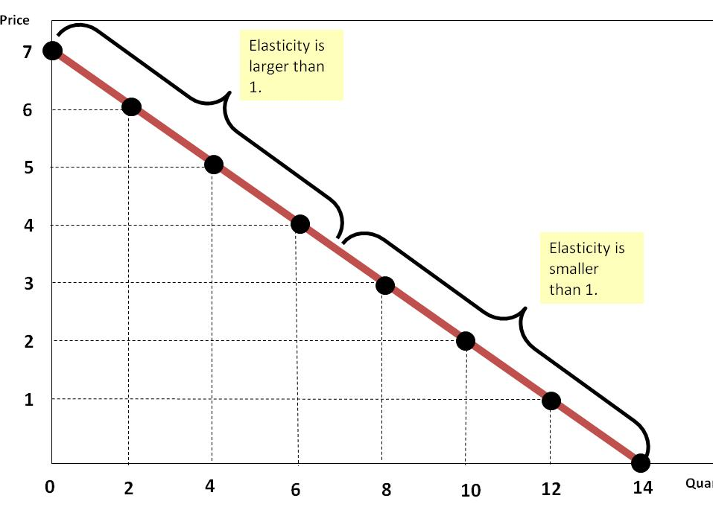
which we also write as E_{P} = [1/slope]x(P/Q)
Slope = ‒½
1/slope = ‒2
E_{P} at P = 6 is
‒2x(6/2) = ‒6
E_{P} at P = 3.5 is
‒2x(3.5/7) = ‒1
E_{P} at P = 1 is
‒2x(1/12) = ‒1/6

Slide 8
Revenue and price elasticity of demand

Slide 9
Total Revenue and the price elasticity of demand
Remember the quotation:
In 1984, the City of Chicago wanted to attract more transit riders with lower fares. J. L. Shofer, research director at Northwestern University’s Transportation Center, wrote:
“Lower fares never make up for loss of revenues. Even when losing riders by increasing fares, revenue usually goes up. It’s a law of economics.”
Total revenue is the amount paid by buyers and received by sellers of a good and computed as the price of the good times the quantity sold. TR = P x Q

Slide 10
Total Revenue
Price
$4.00
P x Q = $400
(revenue)
Demand
0
100
Quantity

Slide 11
Pricing and revenue management Scenario I Scenario II
According to your marketing research department the price elasticity of demand for your product is -2.
You need to increase revenues by 10% to meet your marketing goals.
Your current price is 10 and you are selling 200 units per week.
To achieve your goal, what should be your new price?
According to your marketing research department the price elasticity of demand for your product is -1/2.
You need to increase revenues by 10% to meet your marketing goals.
Your current price is 10 and you are selling 200 units per week.
To achieve your goal, what should be your new price?

Slide 12
Inelastic Demand: How does total revenue change when prices change?
With an inelastic demand curve, an increase in the price leads to a decrease in quantity demanded that is proportionately smaller. Thus, total revenue increases when price increases.
Price
$3.00
P x Q = $240
(revenue)
$1.00
P x Q = $100
(revenue)
Demand
0
80
100
Quantity

Slide 13
Elastic Demand: How does total revenue change when prices change?
With an elastic demand curve, an increase in the price leads to a decrease in quantity demanded that is proportionately larger. Thus, total revenue decreases when price increases.
Price
$5.00
$4.00
Demand
Revenue = $100
Revenue = $200
0
20
50
Quantity

Slide 14
Elasticity and Total Revenue
If demand is elastic at P = Pº, a small increase in price leads to a decrease in total revenue.
This is so because a 1% increase in price leads to a more than 1% decrease in quantity demanded.
If demand is inelastic at P = Pº, a small increase in price leads to an increase in total revenue.
This is so because a 1% increase in price leads to a less than 1% decrease in quantity demanded.

Slide 15
Relationship Between Elasticity and Total Revenue
 | Price Rise | Price Decline
Elastic (E_{P} > 1) | TR decreases | TR increases
Unit Elastic (E_{P} = 1) | TR constant | TR constant
Inelastic (E_{P} < 1) | TR increases | TR decreases
7-15
Notes:
15

Slide 16
Remember: Elasticity along a linear demand curve
Price
7
Elasticity is larger than 1.
6
5
4
Elasticity is smaller than 1.
3
2
1
0
2
4
6
8
10
12
14
Quantity

Slide 17
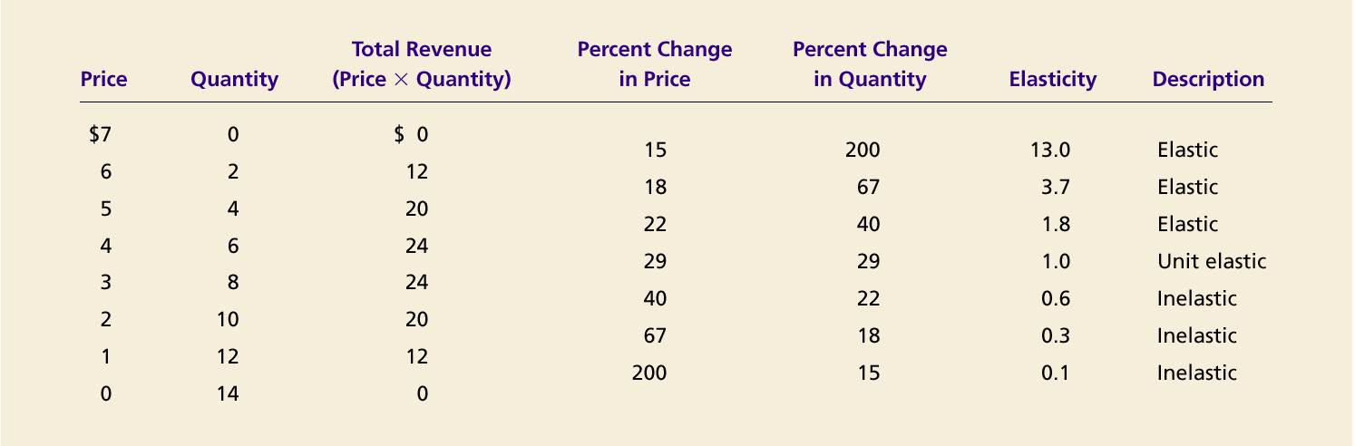
Elasticity and Total Revenue along a Linear Demand Curve

Slide 18
Real-life examples

Slide 19
Three applications of supply, demand, and elasticity
Good news vs bad news for farmers
OPEC
Drugs and crime
Teen smokers
Gasoline tax decreases accidents.

Slide 20
A small example/application
Elasticity, supply shifts, price changes, and revenues

Slide 21

Can good news be bad news for farmers?

Slide 22
Farmers use a new hybrid of wheat so that production per acre increases by 20%!
What happens now?

Slide 23

Figure 8 An Increase in Supply in the Market for Wheat
Price of
Wheat
1. When demand is inelastic,
2. . . . leads
an increase in supply
. . .
to a large fall
S₁
in price . . .
S₂
$3
2
Demand
0
100
110
Quantity of
Wheat
3. . . . and a proportionately smaller
increase in quantity sold. As a result,
revenue falls from $300 to $220.
Copyright©2003 Southwestern/Thomson Learning

Slide 24
Good news (an advance in farm technology) is indeed bad news for farmers. (sharp decline in prices and decline revenues)
That is because the demand for wheat is inelastic.

Slide 25
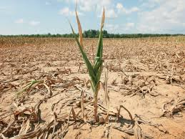
But, bad news can be good news!

Slide 26
Drought Economics: Elasticity and Total Revenue
You’ve all heard a lot about this year’s devastating drought in the Midwest, right? The U.S. Department of Agriculture announced last Friday that the average U.S. cornfield this year will yield less per acre than it has since 1995.
So you’d think that farmers who grow these crops must be really hurting. And that’s certainly the impression you get from media reports. Nick Guetterman, president of the Johnson County Farm Bureau in eastern Kansas, tellsThe New York Times: “You take what you get, that’s all you can do. You go to church and pray.”
But how’s this for a surprising fact? On average, corn growers actually will rake in a record amount of cash from their harvest this year.
Why? It’s simple. Because of the drought, supply is down and the price of corn has gone sky-high. So even a reduced harvest is worth more.
http://www.npr.org/blogs/thesalt/2012/08/14/158752153/secret-side-of-the-drought-corn-farmers-will-benefit

Slide 27
Your turn now
Some real numbers

Slide 28
Corn Production, US
Question #1
Year | Output (bushels per acre) | Price ($ per bushel) | Total revenue ($ per acre)
2009 | 165 | $3.50
2010 | 153 | $5.20
2011 | 147 | $6.20
2012* | 123 | $7.50
Compute the revenues per acre. In which year are revenues highest? Which year lowest?
Estimate the price elasticity of demand at P = 6.20. What assumptions do you need to make?
For 2012: estimated values. Source: USDA
36.7 bushels = 1 tonne

Slide 29
Your turn now

Slide 30
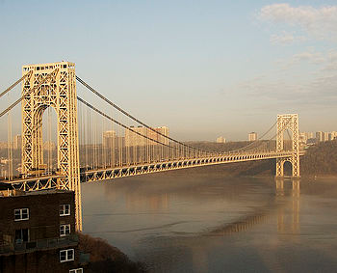
Bridge Toll Example
Current toll for the George Washington Bridge is $2.00/trip.
As of 2013, the George Washington Bridge carries 102 million vehicles per year.
It is the world's busiest motor vehicle bridge.
Notes:
Your example.

Slide 31
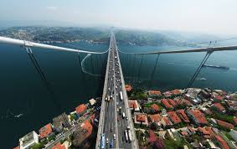
Bridges of FSM and Boğaziçi
Price TL 4.25
Quantity Karayolları Genel Müdürlüğü verilerine göre, geçen yıl Boğaziçi ve Fatih Sultan Mehmet köprülerinden 152 milyon 400 bin taşıt geçti.
http://emlakkulisi.com/gecen-yil-koprulerden-152-milyon-arac-gecti/223746 14 Ocak 2014, Salı

Slide 32
Bridge Toll Example
Current toll for the George Washington Bridge is $2.00/trip.
The quantity demanded is 11,000 trips/hour.
If the price elasticity of demand for bridge trips is E_{P} = –0.5, what is the effect of a 10% toll increase on revenues/hour?
Notes:
Your example.

Slide 33
Bridge Toll Example
Current toll for the George Washington Bridge is $2.00/trip.
The quantity demanded is 11,000 trips/hour.
If the price elasticity of demand for bridge trips is E_{P} = –0.5, what is the effect of a 10% toll increase on revenues/hour?
Notes:
Your example.

Slide 34
Answers

Slide 35
Bridge Toll increase with E_{P} = -0.5 inelastic demand
Price elasticity of demand is –0.5
Toll increase of 10% implies a 5% decline in the quantity demanded.
Initially 11,000 trips. Trips fall to 10,450/hour.
Total revenue rises to $22,990/hour (= 10,450 x $2.20).
Notes:
ditto

Slide 36
Application 3: Drugs and Crime
Over 300 economists have signed on to an open letter to the President, Congress, Governors, and State Legislators asking them to allow this “country to commence an open and honest debate about marijuana prohibition.” The petition states that the undersigned “believe such a debate will favor a regime in which marijuana is legal but taxed and regulated like other goods.”
Notably, three of the economists who have already signed on are Nobel Laureates.

Slide 37
The letter
We, the undersigned, call your attention to the attached report by Professor Jeffrey A. Miron, The Budgetary Implications of Marijuana Prohibition. The report shows that marijuana legalization — replacing prohibition with a system of taxation and regulation — would save $7.7 billion per year in state and federal expenditures on prohibition enforcement and produce tax revenues of at least $2.4 billion annually if marijuana were taxed like most consumer goods. If, however, marijuana were taxed similarly to alcohol or tobacco, it might generate as much as $6.2 billion annually.
The fact that marijuana prohibition has these budgetary impacts does not by itself mean prohibition is bad policy. Existing evidence, however, suggests prohibition has minimal benefits and may itself cause substantial harm.
We therefore urge the country to commence an open and honest debate about marijuana prohibition. We believe such a debate will favor a regime in which marijuana is legal but taxed and regulated like other goods. At a minimum, this debate will force advocates of current policy to show that prohibition has benefits sufficient to justify the cost to taxpayers, foregone tax revenues, and numerous ancillary consequences that result from marijuana prohibition.

Slide 38
IT'S NO TOKE: COLORADO PULLS IN MILLIONS IN MARIJUANA TAX REVENUE
(from FORBES, 03.11.2014)
They say crime pays? Not exactly. Legalize a former crime and tax it and it really pays.
Just ask Colorado. Perhaps not so awkwardly labeled the “Highest State,” Colorado pulled in $2 million in taxes related to the sale of recreational marijuana…in January 2014 alone. Combined with taxes on sales from medicinal marijuana, the state pulled in nearly $3.5 million in pot-related tax revenue. If that trend continues, the state will see more than $40 million in additional tax dollars in 2014. To put that in perspective, that’s approximately 1% of the total annual budgets for Delaware, South Dakota, Montana or West Virginia.

Slide 39
Application 3: Drugs and Crime
How elasticity affects the market for illegal goods
In an important new study, world-renowned economists argue that when demand for a good is inelastic, the cost of making consumption illegal exceeds the gain. Their paper in the Journal of Political Economy is a definitive explanation of the economics of illegal goods and a thoughtful explication of the costs of enforcement.
The authors demonstrate how the elasticity of demand is crucial to understanding the effects of punishment on suppliers. Enforcement raises costs for suppliers, who must respond to the risk of imprisonment and other punishments. This cost is passed on to the consumer, which induces lower consumption when demand is relatively elastic. However, in the case of illegal goods like drugs--where demand seems inelastic--higher prices lead not to less use, but to an increase in total spending. In the case of drugs, then, the authors argue that excise taxes and persuasive techniques –such as advertising--are far more effective uses of enforcement expenditures. "This analysis…helps us understand why the War on Drugs has been so difficult to win…why efforts to reduce the supply of drugs leads to violence and greater power to street gangs and drug cartels," conclude the authors. "The answer lies in the basic theory of enforcement developed in this paper."

Slide 40
Application 3: Drugs and Crime
(a) Drug Interdiction
(b) Drug Education
Price of Drugs
Price of Drugs
1. Drug interdiction reduces the supply of drugs…
S₂
1. Drug education reduces the demand for drugs…
S₁
Supply
P₂
P₁
P₁
P₂
D₁
2. … which raises the price…
2. … which reduces the price…
Demand
D₂
Q₂
Q₁
Quantity of Drugs
Q₂
Q₁
Quantity of Drugs
3. … and reduces the quantity sold.
3. … and reduces the quantity sold.

Slide 41
You can read the chapter on Elasticity here: http://www.swlearning.com/economics/mankiw/principles2e/rep/dl/ch05.pdf
End of the lecture

